Slide 1
Review and Preview
Data Structures and Algorithms
Nanjing University, Fall 2020
郑朝栋

Slide 2
Online Algorithms

Slide 3
Online Algorithms
Input is provided to the algorithm piece-by-piece gradually, instead of being entirely available from the beginning.
InsertionSort is an online sorting algorithm; SelectionSort is an offline sorting algorithm.
Why care about online algorithms?
Input is too large to fit into main-memory or hard-drive…
Example: Reservoir sampling
Nature of the problem…
Example: Secretary problem

Slide 4
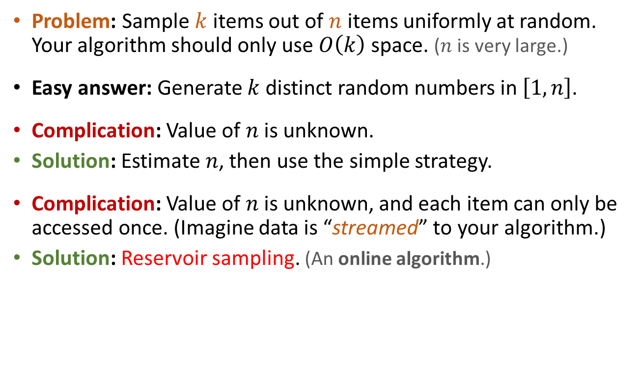
A Simple Sampling Problem
Problem: Sample $k$ items out of $n$ items uniformly at random. Your algorithm should only use $O\left(k\right)$ space. ($n$ is very large.)
Easy answer: Generate $k$ distinct random numbers in $\left[1,n\right]$.
Complication: Value of $n$ is unknown.
Solution: Estimate $n$, then use the simple strategy.
Complication: Value of $n$ is unknown, and each item can only be accessed once. (Imagine data is “streamed” to your algorithm.)
Solution: Reservoir sampling. (An online algorithm.)

Slide 5
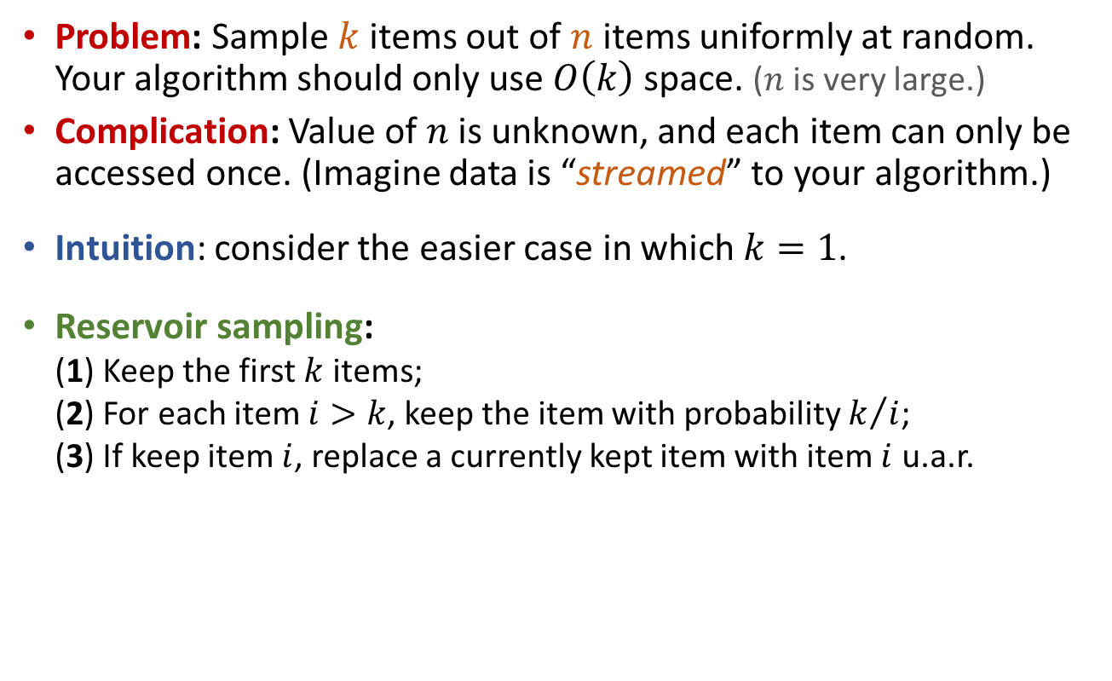
Reservoir Sampling
Problem: Sample $k$ items out of $n$ items uniformly at random. Your algorithm should only use $O\left(k\right)$ space. ($n$ is very large.)
Complication: Value of $n$ is unknown, and each item can only be accessed once. (Imagine data is “streamed” to your algorithm.)
Intuition: consider the easier case in which $k=1$.
Reservoir sampling: (1) Keep the first $k$ items; (2) For each item $i>k$, keep the item with probability $k/i$; (3) If keep item $i$, replace a currently kept item with item $i$ u.a.r.

Slide 6
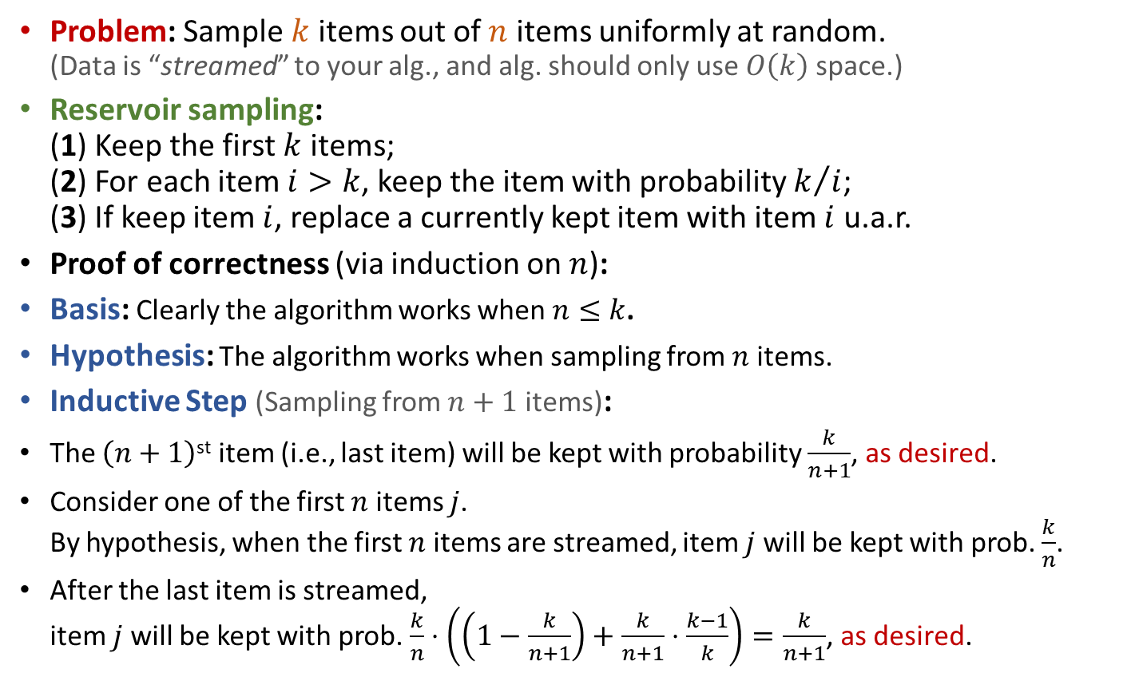
Reservoir Sampling
Problem: Sample $k$ items out of $n$ items uniformly at random. (Data is “streamed” to your alg., and alg. should only use $O\left(k\right)$ space.)
Reservoir sampling: (1) Keep the first $k$ items; (2) For each item $i>k$, keep the item with probability $k/i$; (3) If keep item $i$, replace a currently kept item with item $i$ u.a.r.
Proof of correctness (via induction on $n$):
Basis: Clearly the algorithm works when $n≤k$.
Hypothesis: The algorithm works when sampling from $n$ items.
Inductive Step (Sampling from $n+1$ items):
The $\left(n+1\right)$^{st} item (i.e., last item) will be kept with probability $\frac{k}{n+1}$, as desired.
Consider one of the first $n$ items $j$. By hypothesis, when the first $n$ items are streamed, item $j$ will be kept with prob. $\frac{k}{n}$.
After the last item is streamed, item $j$will be kept with prob. $\frac{k}{n}⋅\left(\left(1−\frac{k}{n+1}\right)+\frac{k}{n+1}⋅\frac{k−1}{k}\right)=\frac{k}{n+1}$, as desired.

Slide 7









The Secretary Problem
Setup: You want to hire a secretary among $n$ applicants. After interviewing an applicant, you must immediately decide whether to hire or reject the applicant. Once rejected, an applicant cannot be recalled. During each interview, you can give a score to the applicant.
Problem: Strategy to maximize the chance of hiring the best applicant.
?
Also known as: 相亲问题、麦穗问题、……

Slide 8

The Secretary Problem
Setup: You want to hire a secretary among $n$ applicants. After interviewing an applicant, you must immediately decide whether to hire or reject the applicant. Once rejected, an applicant cannot be recalled. During each interview, you can give a score to the applicant.
Problem: Strategy to maximize the chance of hiring the best applicant?
Need an online algorithm, as decision for each applicant must be made immediately, and rejected applicants cannot be recalled.
?

Slide 9
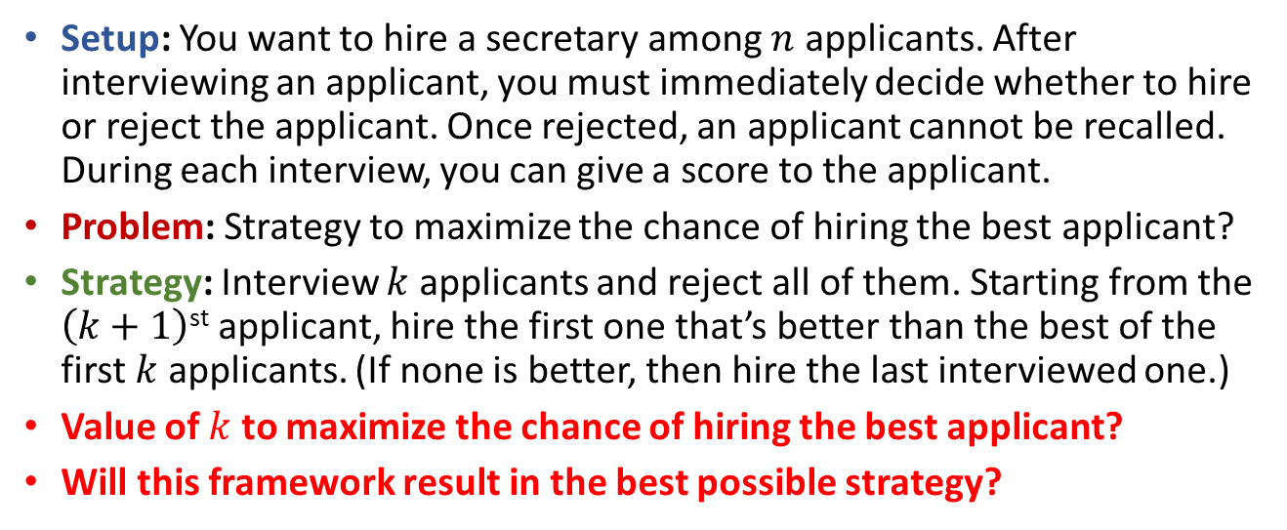
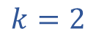
The Secretary Problem
Setup: You want to hire a secretary among $n$ applicants. After interviewing an applicant, you must immediately decide whether to hire or reject the applicant. Once rejected, an applicant cannot be recalled. During each interview, you can give a score to the applicant.
Problem: Strategy to maximize the chance of hiring the best applicant?
Strategy: Interview $k$ applicants and reject all of them. Starting from the $\left(k+1\right)$^{st} applicant, hire the first one that’s better than the best of the first $k$ applicants. (If none is better, then hire the last interviewed one.)
Value of $k$ to maximize the chance of hiring the best applicant?
Will this framework result in the best possible strategy?
$$k=2$$
82
67
75
80
83
95

Slide 10
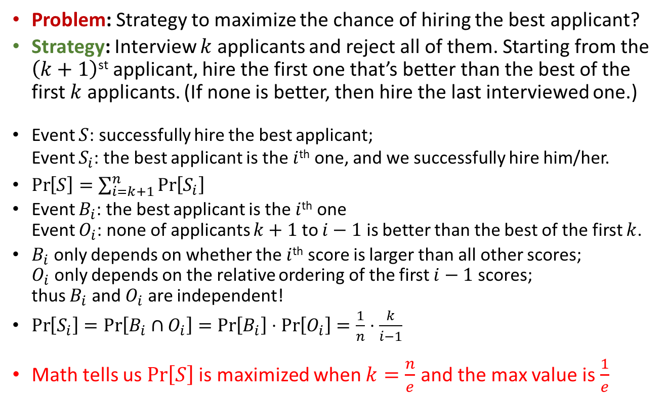
The Secretary Problem
Problem: Strategy to maximize the chance of hiring the best applicant?
Strategy: Interview $k$ applicants and reject all of them. Starting from the $\left(k+1\right)$^{st} applicant, hire the first one that’s better than the best of the first $k$ applicants. (If none is better, then hire the last interviewed one.)
Event $S$: successfully hire the best applicant; Event $S_{i}$: the best applicant is the $i$^{th} one, and we successfully hire him/her.
$\operatorname{Pr}\left[S\right]=\sum_{i=k+1}^{n}{\operatorname{Pr}\left[S_{i}\right]}$
Event $B_{i}$: the best applicant is the $i$^{th} one Event $O_{i}$: none of applicants $k+1$ to $i−1$ is better than the best of the first $k$.
$B_{i}$ only depends on whether the $i$^{th} score is larger than all other scores; $O_{i}$ only depends on the relative ordering of the first $i−1$ scores; thus $B_{i}$ and $O_{i}$ are independent!
$\operatorname{Pr}\left[S_{i}\right]=\operatorname{Pr}\left[B_{i}∩O_{i}\right]=\operatorname{Pr}\left[B_{i}\right]⋅\operatorname{Pr}\left[O_{i}\right]=\frac{1}{n}⋅\frac{k}{i−1}$
Math tells us $\operatorname{Pr}\left[S\right]$ is maximized when $k=\frac{n}{e}$ and the max value is $\frac{1}{e}$

Slide 11
Distributed Algorithms

Slide 12

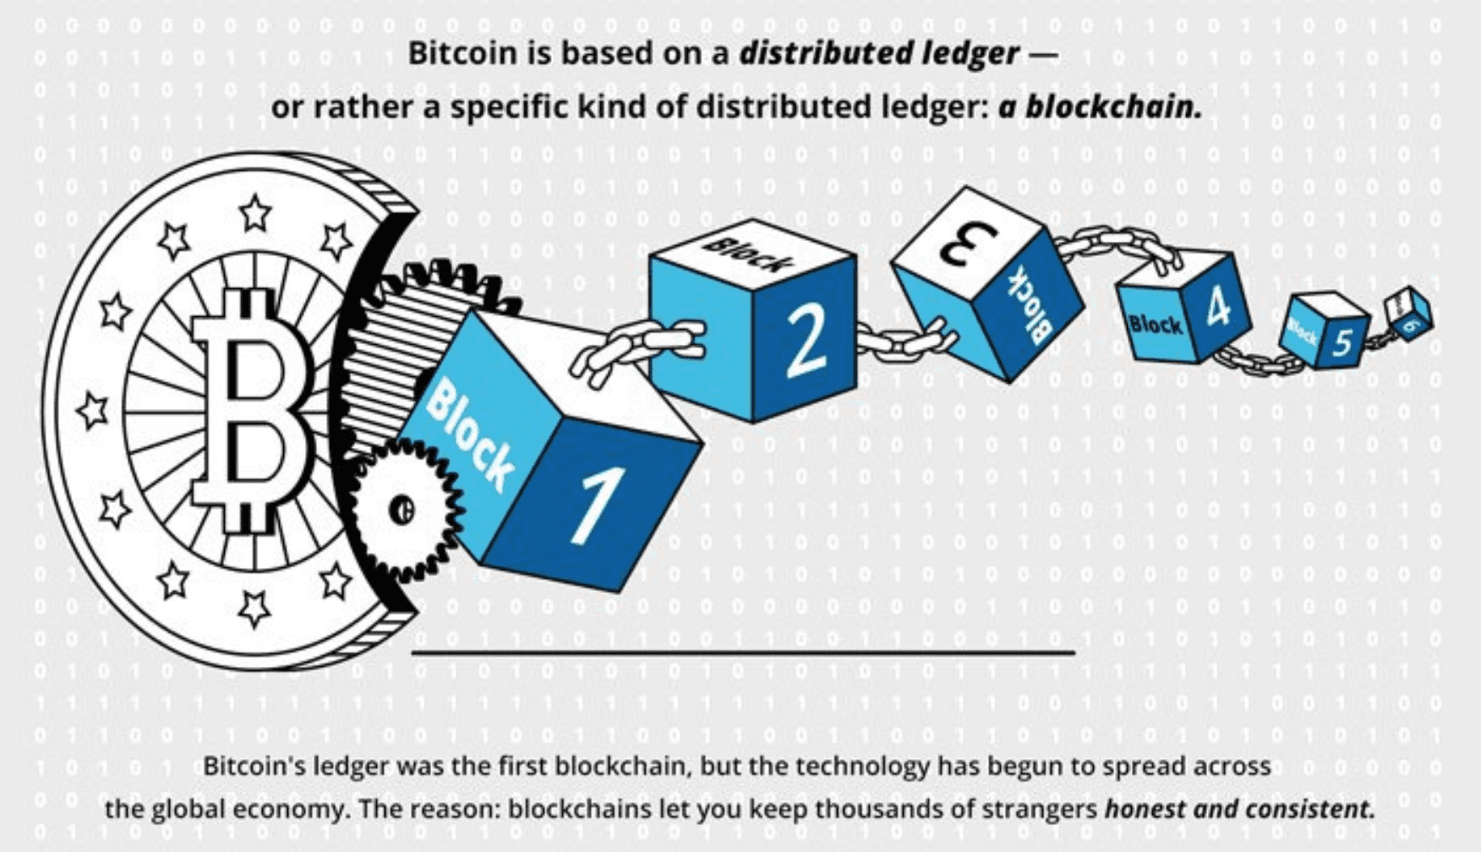


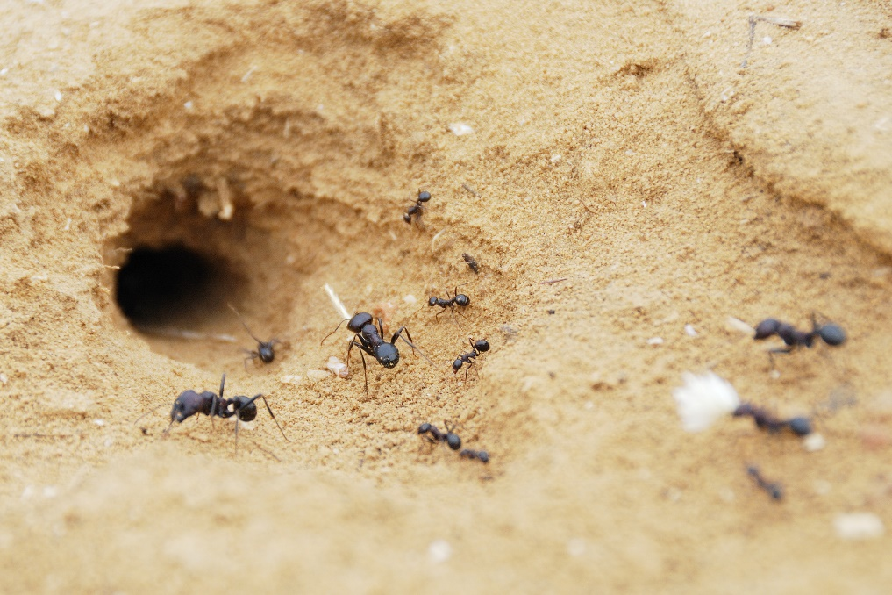
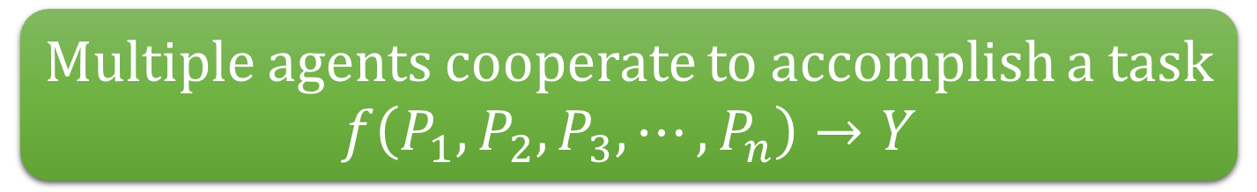
Distributed computing is everywhere!
So what is distributed computing?
Multiple agents cooperate to accomplish a task
$$f\left(P_{1},P_{2},P_{3},⋯,P_{n}\right)→Y$$

Slide 13



Principles of Distributed Computing
We don’t study how to use them, but study how to build them.
For example, the distributed algorithms within them.

Slide 14



Modelling distributed systems: Shared Memory vs Message Passing
Shared memory:
Processors exchange information via read/write shared registers.
Message passing:
Nodes exchange information via send/receive messages to/from neighbours.
Initially, each processor/node only knows local information!

Slide 15
Understanding distributed algorithms: Complexity Measure
Time complexity: how long (e.g., number of rounds) is needed to accomplish the task in the worst case.
Message complexity: number of messages needed to transmit to accomplish the task in the worst case.
Space complexity: size of (local or global) memory needed to accomplish the task in the worst case.
Feasibility: can the given task be accomplished at all.

Slide 16
Challenges in distributed computing
Communication:
Now computation is “free”, but not communication!
Synchrony:
What if your message takes a year to reach me?
Fault-tolerance:
Oops, someone unplug the power cable?!
Locality:
Do I need to know everything before I can compute the result?
Symmetry breaking:
We are going nowhere if everyone keeps doing the same thing!
and so on…

Slide 17
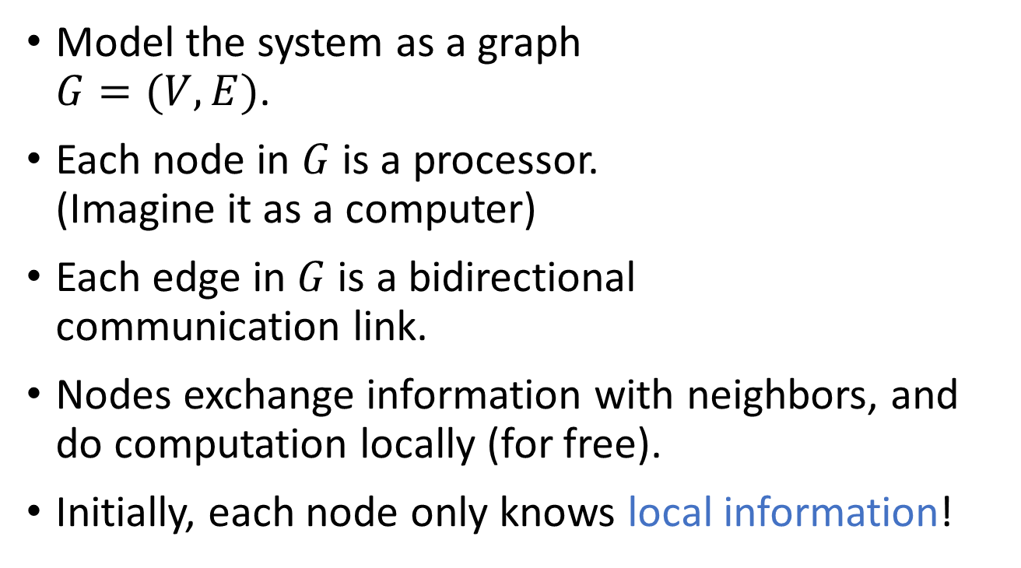
Message passing model, in detail
Model the system as a graph $G=(V,E)$.
Each node in $G$ is a processor. (Imagine it as a computer)
Each edge in $G$ is a bidirectional communication link.
Nodes exchange information with neighbors, and do computation locally (for free).
Initially, each node only knows local information!

Slide 18



Other aspects of the model
Synchrony:
Synchronous: message delays are bounded, we can simulate global notion of “round”.
Asynchronous: message delays are unbounded, but each message will be delivered eventually.
Failure:
Link failure, crash failure, Byzantine failure.
time

Slide 19


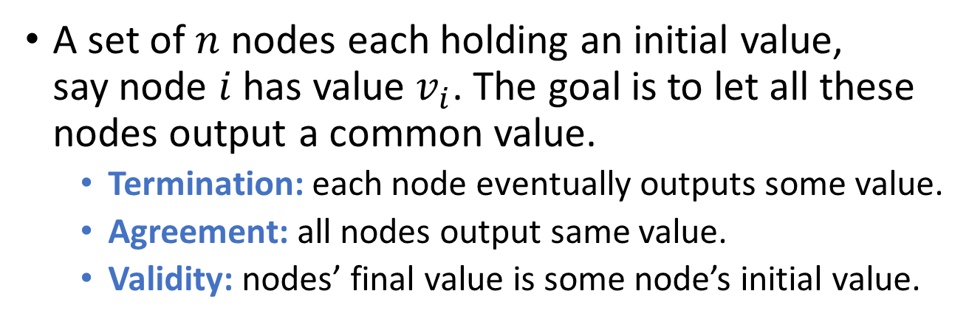
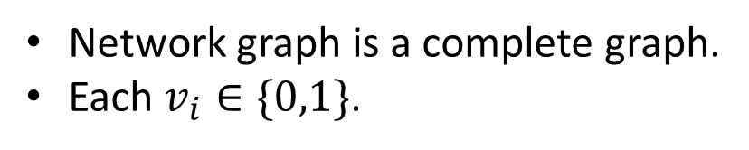
Case study: Consensus
A set of $n$ nodes each holding an initial value, say node $i$ has value $v_{i}$. The goal is to let all these nodes output a common value.
Termination: each node eventually outputs some value.
Agreement: all nodes output same value.
Validity: nodes’ final value is some node’s initial value.
?
Network graph is a complete graph.
Each $v_{i}∈\{0,1\}$.

Slide 20
Consensus without failures
A set of $n$ nodes each holding an initial value, say node $i$ has value $v_{i}$. The goal is to let all these nodes output a common value.
Termination: each node eventually outputs some value.
Agreement: all nodes output same value.
Validity: nodes’ final value is some node’s initial value.
Assume there is no failure at all, what algorithm can you come up with?
0
0
1
Each node simply sends its value to all other nodes, then decides output based on all received messages according to some pre-defined rule.
1
1

Slide 21




Sync. Consensus with crash failures

Slide 22
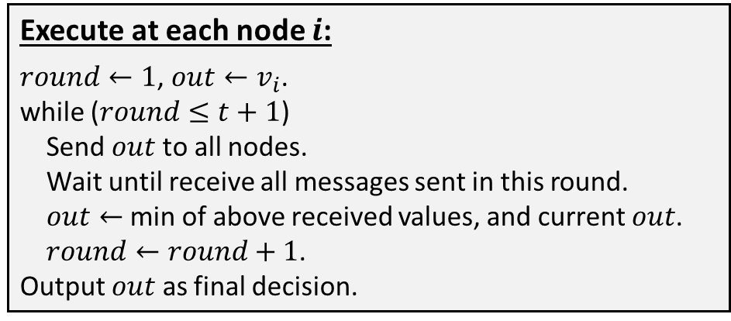
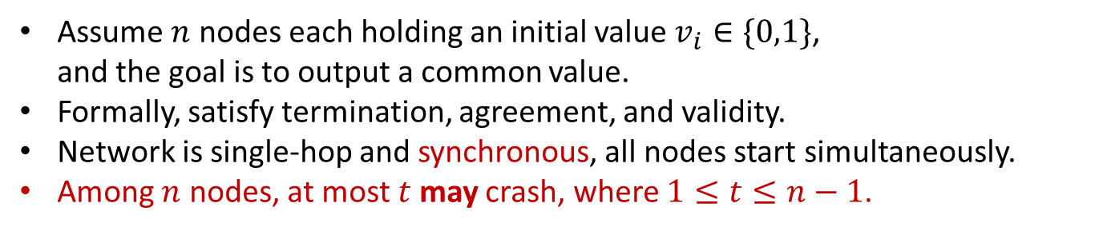
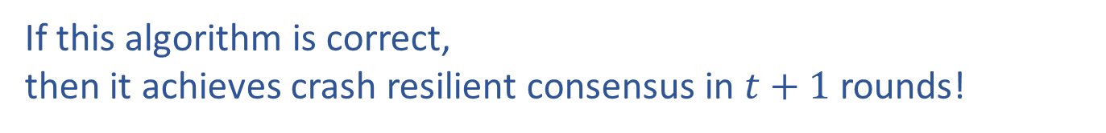
Sync. consensus with crash failures
Assume $n$ nodes each holding an initial value $v_{i}∈\{0,1\}$, and the goal is to output a common value.
Formally, satisfy termination, agreement, and validity.
Network is single-hop and synchronous, all nodes start simultaneously.
Among $n$ nodes, at most $t$ may crash, where $1≤t≤n−1$.
Execute at each node $i$:
$round←1$, $out←v_{i}$.
while ($round≤t+1$)
Send $out$ to all nodes.
Wait until receive all messages sent in this round.
$out←$ min of above received values, and current $out$.
$round←round+1$.
Output $out$ as final decision.
0
0
1
1
1
If this algorithm is correct, then it achieves crash resilient consensus in $t+1$ rounds!

Slide 23

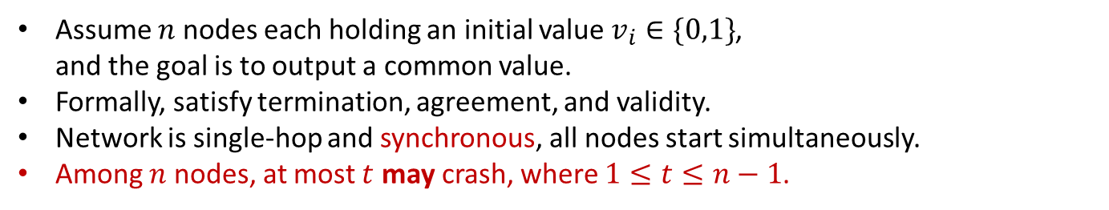
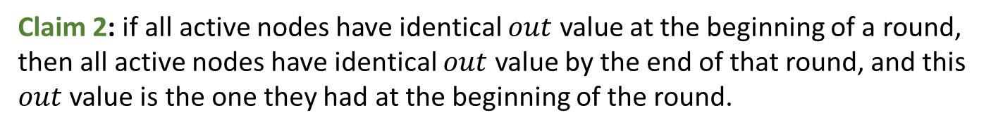

Assume $n$ nodes each holding an initial value $v_{i}∈\{0,1\}$, and the goal is to output a common value.
Formally, satisfy termination, agreement, and validity.
Network is single-hop and synchronous, all nodes start simultaneously.
Among $n$ nodes, at most $t$ may crash, where $1≤t≤n−1$.
Execute at each node $i$:
$round←1$, $out←v_{i}$.
while ($round≤t+1$)
Send $out$ to all nodes.
Wait until receive all messages sent in this round.
$out←$ min of above received values, and current $out$.
$round←round+1$.
Output $out$ as final decision.
0
0
1
1
1
Definition 1: call a round clean if in that round no node crashes.
Claim 1: by the end of a clean round, all active nodes have identical $out$ value.
Claim 2: if all active nodes have identical $out$ value at the beginning of a round, then all active nodes have identical $out$ value by the end of that round, and this $out$ value is the one they had at the beginning of the round.
Termination, agreement, and validity can be easily proved now!

Slide 24

Async. consensus with crash failures
Assume $n$ nodes each holding an initial value $v_{i}∈\{0,1\}$, and the goal is to output a common value.
Formally, satisfy termination, agreement, and validity.
Network is single-hop and asynchronous, all nodes start simultaneously.
Among $n$ nodes, at most $t$ may crash, where $1≤t≤n−1$.
Execute at each node $i$:
$round←1$, $out←v_{i}$.
while ($round≤t+1$)
Send $out$ to all nodes.
Wait until receive all messages sent in this round.
$out←$ min of above received values, and current $out$.
$round←round+1$.
Output $out$ as final decision.
0
0
1
1
1
The above algorithm no longer works!
Specifically, nodes might never stop, violating termination.

Slide 25




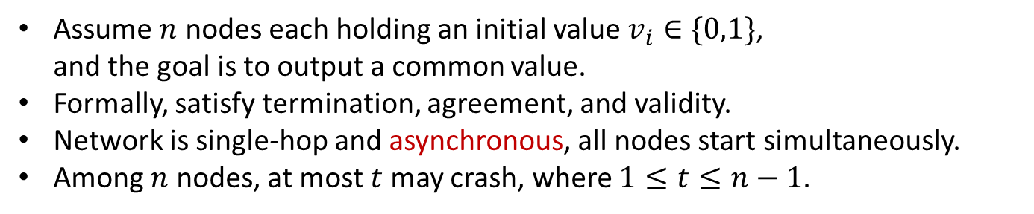
FLP Impossibility
Assume $n$ nodes each holding an initial value $v_{i}∈\{0,1\}$, and the goal is to output a common value.
Formally, satisfy termination, agreement, and validity.
Network is single-hop and asynchronous, all nodes start simultaneously.
Among $n$ nodes, at most $t$ may crash, where $1≤t≤n−1$.
In fact, no algorithm will work, even when $t=1$.
Theorem: in asynchronous message passing model, there is no consensus algorithm that can tolerate even a single crash failure.
Proved by Michael Fischer, Nancy Lynch, and Michael Paterson in 1983, in paper “Impossibility of Distributed Consensus with One Faulty Process”.
The fundamental difficulty is that a node missing a message cannot know whether it’s due to delay or failure.

Slide 26



But, wait a minute…
Assume $n$ nodes each holding an initial value $v_{i}∈\{0,1\}$, and the goal is to output a common value.
Formally, satisfy termination, agreement, and validity.
Network is single-hop and asynchronous, all nodes start simultaneously.
Among $n$ nodes, at most $t$ may crash, where $1≤t≤n−1$.
FLP Impossibility: in asynchronous message passing model, there is no consensus algorithm that can tolerate even a single crash failure.
Real world networks are asynchronous, real world has consensus problems, yet these problems are solved!!!

Slide 27





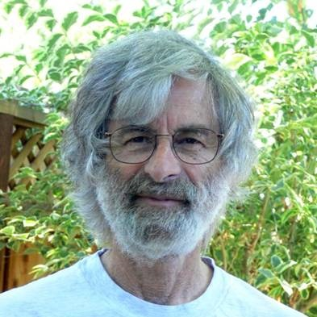
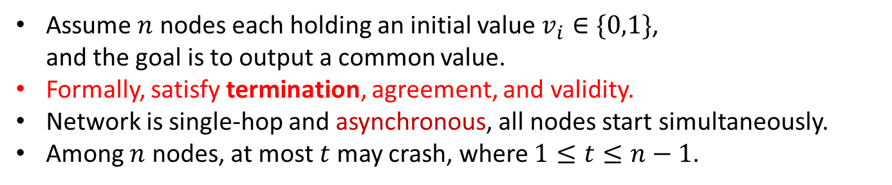
Paxos
Assume $n$ nodes each holding an initial value $v_{i}∈\{0,1\}$, and the goal is to output a common value.
Formally, satisfy termination, agreement, and validity.
Network is single-hop and asynchronous, all nodes start simultaneously.
Among $n$ nodes, at most $t$ may crash, where $1≤t≤n−1$.
FLP Impossibility: in asynchronous message passing model, there is no consensus algorithm that can tolerate even a single crash failure.
Paxos gives up “termination”: nodes may never stop in extreme cases, but nodes always output correct values, if they ever output any values.
Paxos is proposed by Leslie Lamport.
It is both easy and difficult :P

Slide 28





Consensus with Byzantine failures
Byzantine Generals Problem:
A group of generals need to agree on whether to attack a city.
Each general has own initial opinion.
Only all-out attack can succeed.
Communicate via reliable messengers.
But some generals are traitors!
Byzantine failure means deviate from protocol arbitrarily. It is worse than crash failure.
Being able to tolerate Byzantine failure is important for some critical systems.

Slide 29

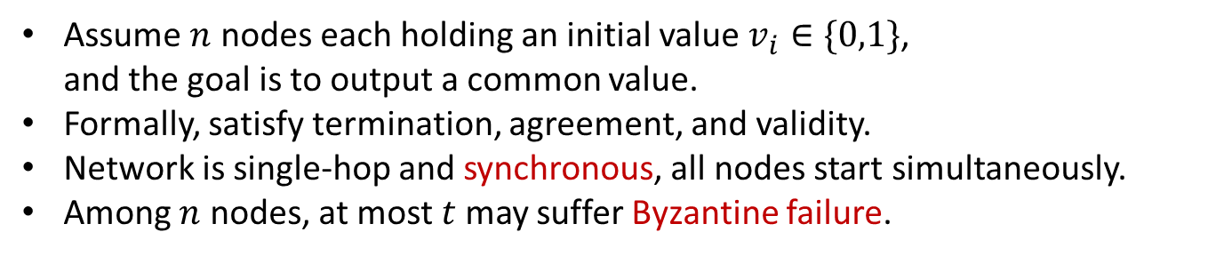
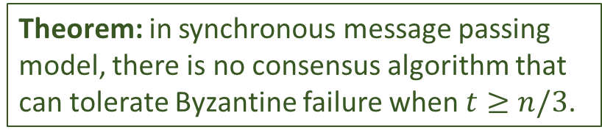
Consensus with Byzantine failures
Assume $n$ nodes each holding an initial value $v_{i}∈\{0,1\}$, and the goal is to output a common value.
Formally, satisfy termination, agreement, and validity.
Network is single-hop and synchronous, all nodes start simultaneously.
Among $n$ nodes, at most $t$ may suffer Byzantine failure.
Theorem: in synchronous message passing model, there is no consensus algorithm that can tolerate Byzantine failure when $t≥n/3$.

Slide 30
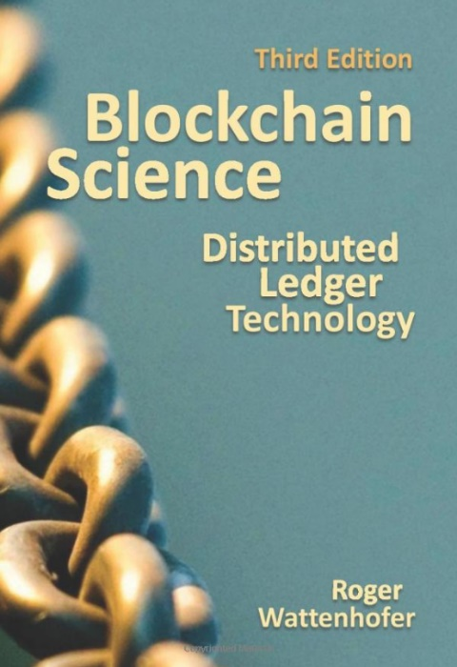

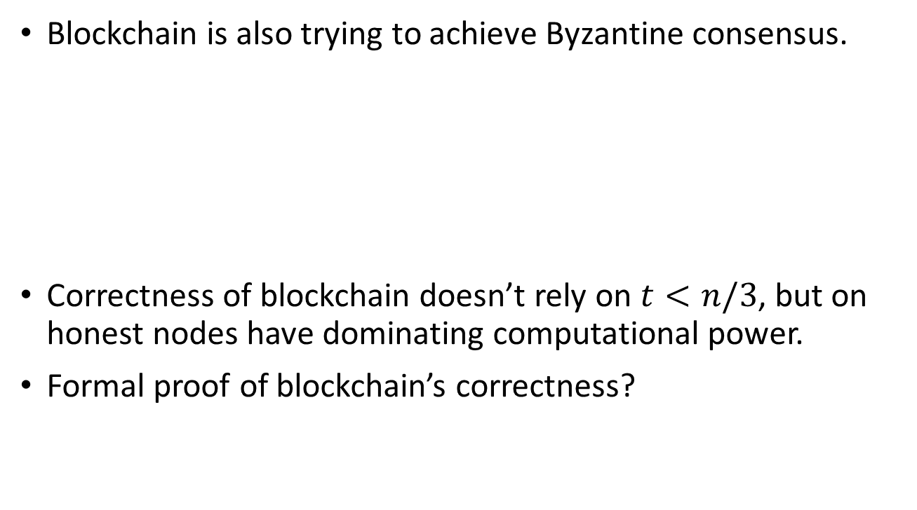
Recent developments: Blockchain and Byzantine Consensus
Blockchain is also trying to achieve Byzantine consensus.
Correctness of blockchain doesn’t rely on $t<n/3$, but on honest nodes have dominating computational power.
Formal proof of blockchain’s correctness?

Slide 31

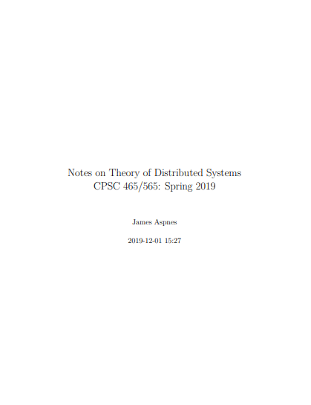
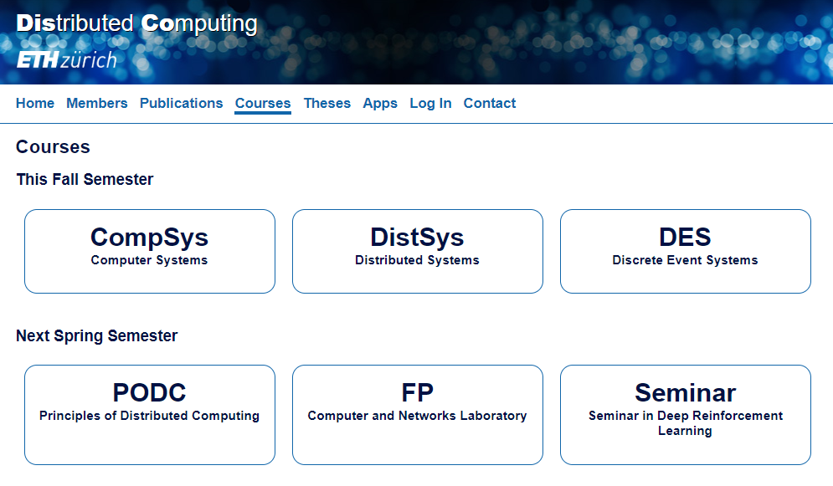
If you want to know more…
Attiya and Welch, Distributed Computing: Fundamentals, Simulations, and Advanced Topics (2ed)
James Aspnes, Lecture notes on “Theory of Distributed Systems”
DISCO group of ETHZ, Various courses on distribute computing
Notes:
ETHZ 苏黎世联邦理工

